Slide 1
Structured Design
(Mapping data flow into architecture)

Slide 2
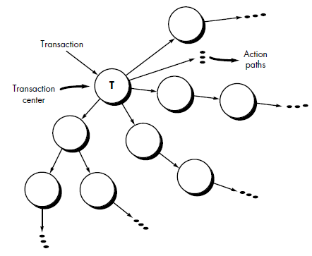
Mapping Data flow into Architecture
Determine flow
Transform
Conversion of data from external to internal form (incoming flow)
Transform center
Conversion from internal to external form (outgoing flow)
Transaction
Single data item triggers data flows along one of many paths

Slide 3
Example
Our research indicates that the market for home security systems is growing at a rate of 40 percent per year. We would like to enter this market by building a microprocessor-based home security system that would protect against and/or recognize a variety of undesirable "situations" such as illegal entry, fire, flooding, and others. The product, tentatively called SafeHome, will use appropriate sensors to detect each situation, can be programmed by the homeowner, and will automatically telephone a monitoring agency when a situation is detected.

Slide 4
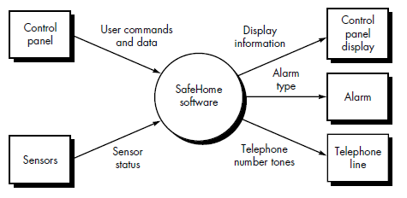
Example
Safe Home is a home management product that allows homeowners to control their homes using their PC and Mobile phone remotely. Home security, home surveillance, appliance and device control are a few functionalities that are provided by the Safe Home product. Initial design tells that both the Internet interface and the other Graphical User Interface (GUI) are both part of external communication management module. Security related hardware management includes control panel processing (i.e. keypad and display function), detector management (i.e. scheduler and sensors etc.), alarm processing (i.e. phone communication, alarm management etc.). Other modules include Surveillance module and Home management module. Surveillance module monitors the inappropriate activities around and inside the home. Home management module allows the users to control devices (e.g. switch off A/C, tube light etc.).

Slide 5
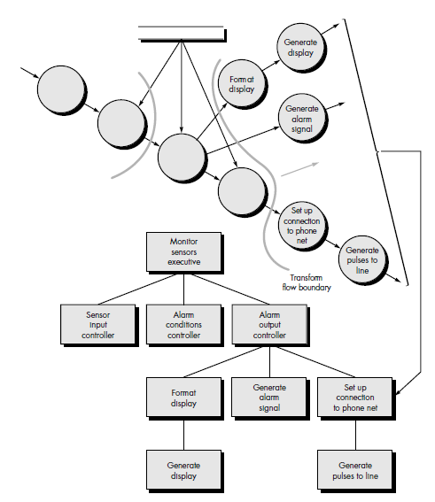
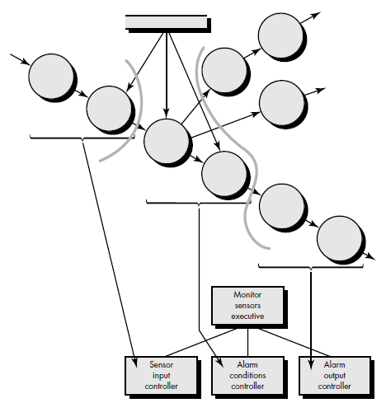
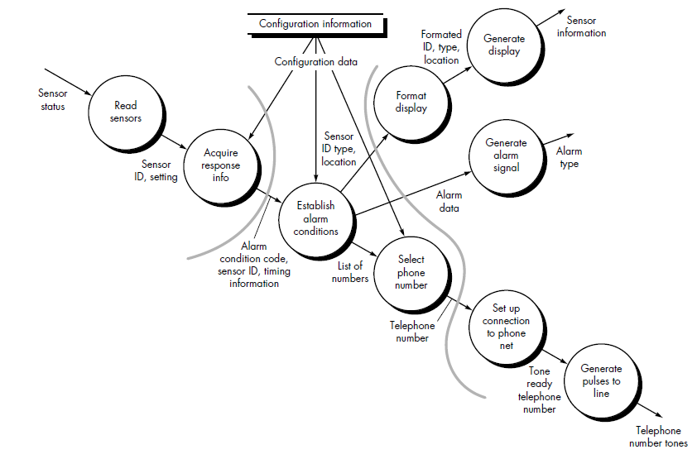
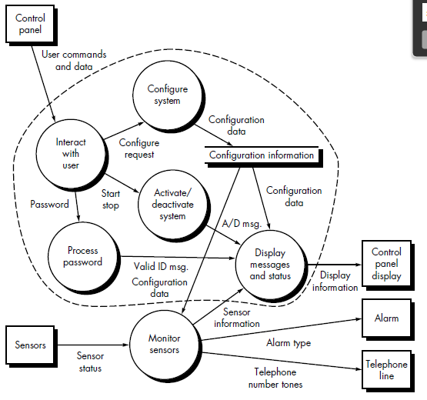
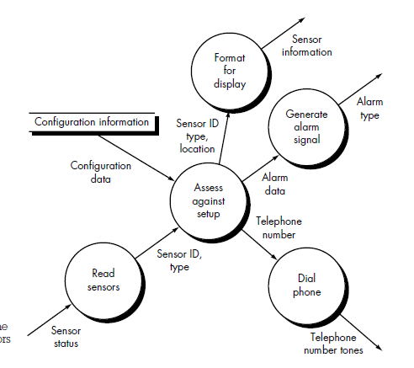
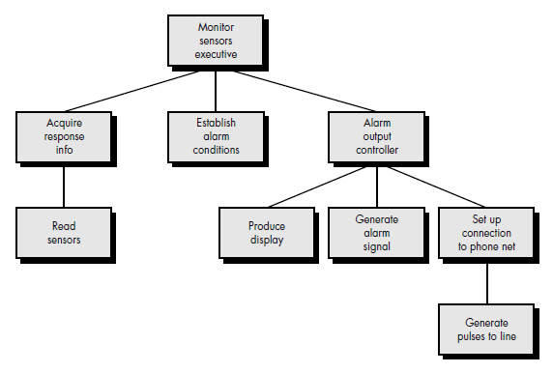
Design Steps
Review the fundamental system model
Review and refine DFD
Determine flows
Specify incoming and outgoing flow boundaries
Perform 1st level factoring
Perform 2nd level factoring

Slide 6
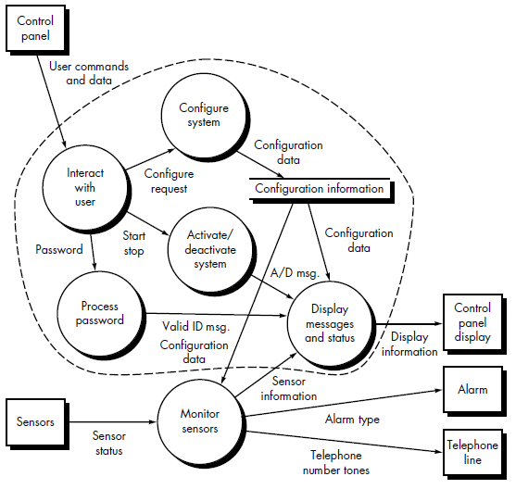
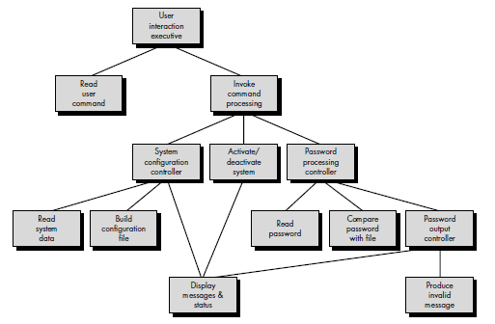
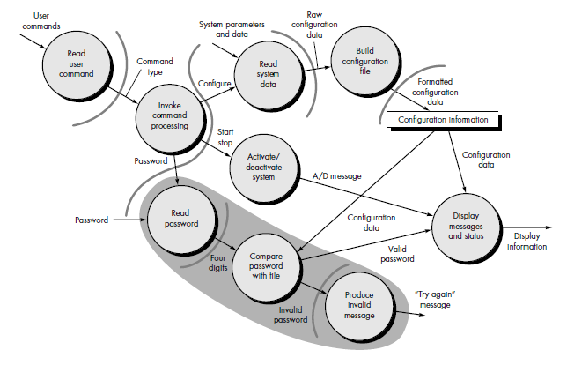
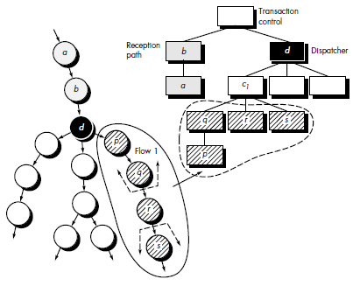
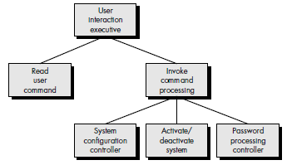
Review the fundamental system model
Review and refine DFD
Determine flows
Specify incoming and outgoing flow boundaries
Perform 1st level factoring
Perform 2nd level factoring

Slide 7
References
SE book by Pressman

